Slide 1

Enhancing your productivity with AI
Joe Arday
MBCS FCCT FRSA BSc (Hons) PGCE
LinkedIn: https://www.linkedin.com/in/joearday/
Twitter:
@TheAverageArday

Slide 2
Agenda for the Session
Introductions
Examples of enhancing productivity with AI (e.g. Google Notebook LM, Jotform app and capstone project on ethical AI in an education setting)
Recommend CPD courses for Edtech and AI skills
Questions
LinkedIn: https://www.linkedin.com/in/joearday/
Twitter:
@TheAverageArday

Slide 3
Introductions
LinkedIn: https://www.linkedin.com/in/joearday/
Twitter:
@TheAverageArday

Slide 4
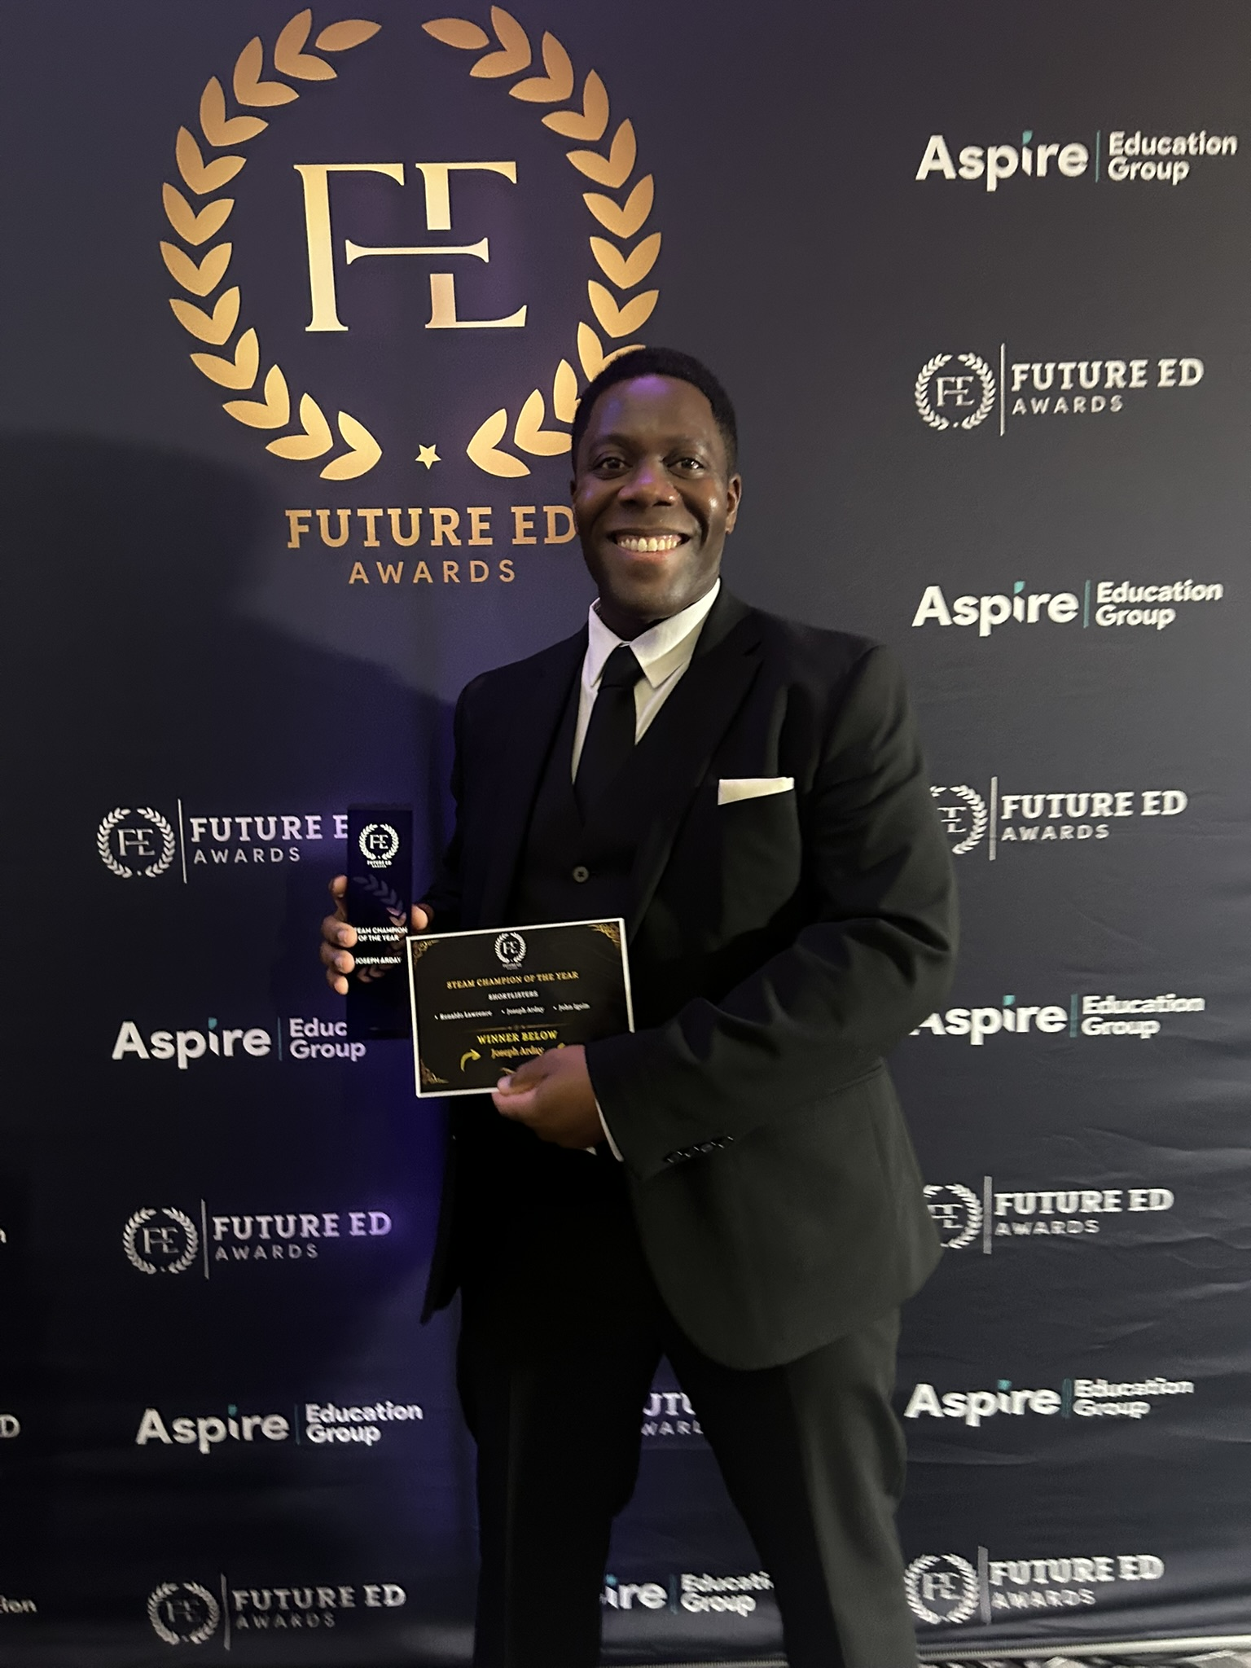
A bit about me – Joe Arday MBCS FCCT FRSA
Neurodivergent Computer Science, AI, EdTech and STEM educator with nearly 20 years' experience working with schools and several organisations in education.
AI Citizen of the Year 2025 Runner Up (Highly Commended) by the National AI Awards
Inaugural STEAM Champion of the Year 2025 Winner by Future Ed Group Awards
Chartered College of Teaching / Department for Education Edtech Evidence Board Advisory member since 2025.
BETT UK advisory board member 2024 – 2026
BCS council member and committee member for various groups in computer science education, diversity and industry.
Notes:
British Ghanaian Computer Science educator and former tech professional diagnosed with Autism Spectrum Disordered (ASD) since childhood.
1) Former tech professional with a degree in BSc (Hons) Information Systems and PGCE in Applied ICT.
2) Named as one of several black educators in a school educational resource called “Celebrating Black Computing” by Elizabeth Sparrow in Black History Month 2022.
3) Former Raspberry Pi SIGCSE Working Group Panel Member from 2021 to 2022.
4) Fellowships with the Royal Society of Arts (FRSA) and Chartered College of Teaching (FCCT). Professional member of the British Computing Society (MBCS) since 2021.
5) Mentor of BCS “My Digital Future” programme.
6) Alumni mentor for Kingston University’s “Elevate” programme.
7) Volunteer STEM Ambassador with STEM Learning UK since 2019.
8) Mentor and guest speaker in helping to raise aspirations in young people in education.
9) Volunteer industry expert for programmes such as Apps for Good and Tech She can to name a few.
10) Volunteer digital champion supporting adults in using tech with the Essex Digital programme (e.g. Essex County Council).

Slide 5
Examples of enhancing productivity with AI
Google Notebook LM, Jotform app and capstone project on ethical AI in an education setting
LinkedIn: https://www.linkedin.com/in/joearday/
Twitter:
@TheAverageArday

Slide 6
Examples of AI enhancing productivity in education
Generative AI in education – teachers are being encouraged to use AI support a range of tasks from marking to report writing.
Introduction of AI tutors to support 450,000 disadvantaged students, which will be available in 2027 to deal with teacher storages across the UK.
Introduction of digital exams for GCSEs and / or A levels by major exam boards including using AI to mark exams.
LinkedIn: https://www.linkedin.com/in/joearday/
Twitter:
@TheAverageArday
Notes:
Link(s):
450,000 disadvantaged pupils could benefit from AI tutoring tools - GOV.UK
Edtech and AI companies invited to help build safe AI tutoring tools for disadvantaged pupils - GOV.UK
Using AI in education settings: support materials - GOV.UK
Generative artificial intelligence (AI) in education - GOV.UK
Research on parent and pupil attitudes towards the use of AI in education - GOV.UK
Generative AI in education: educator and expert views - GOV.UK
Using AI and technology in education to improve pupil outcomes and reduce staff workload - A roadmap for modern digital government
Research review series: computing - GOV.UK
Curriculum and assessment review final report - key points for computing
Computing and digital literacy in the Curriculum and Assessment Review - Teach Computing
Reformed school curriculum will feature AI, media literacy and a new Computing GCSE | BCS
Curriculum and Assessment Review Final Report - GOV.UK
Digital exams to be introduced within years - AQA - BBC News
'Cause for anxiety' over AI being used by students to cheat, says exams regulator boss | UK News | Sky News
AI and the Future of Skills, Volume 2 (EN)

Slide 7
Notebook LM – Setting the scenario
Students often tell me “I am not sure how to revise for the end of topic test, class test or exam” or struggle to recap on previous learning taught outside the classroom.
Creation of the topic revision notebooks using lesson presentations and / or resources to produce podcasts, flashcards, video explanations, quizzes, mind maps etc to support all students especially SEND students with understanding of the topic.
LinkedIn: https://www.linkedin.com/in/joearday/
Twitter:
@TheAverageArday

Slide 8
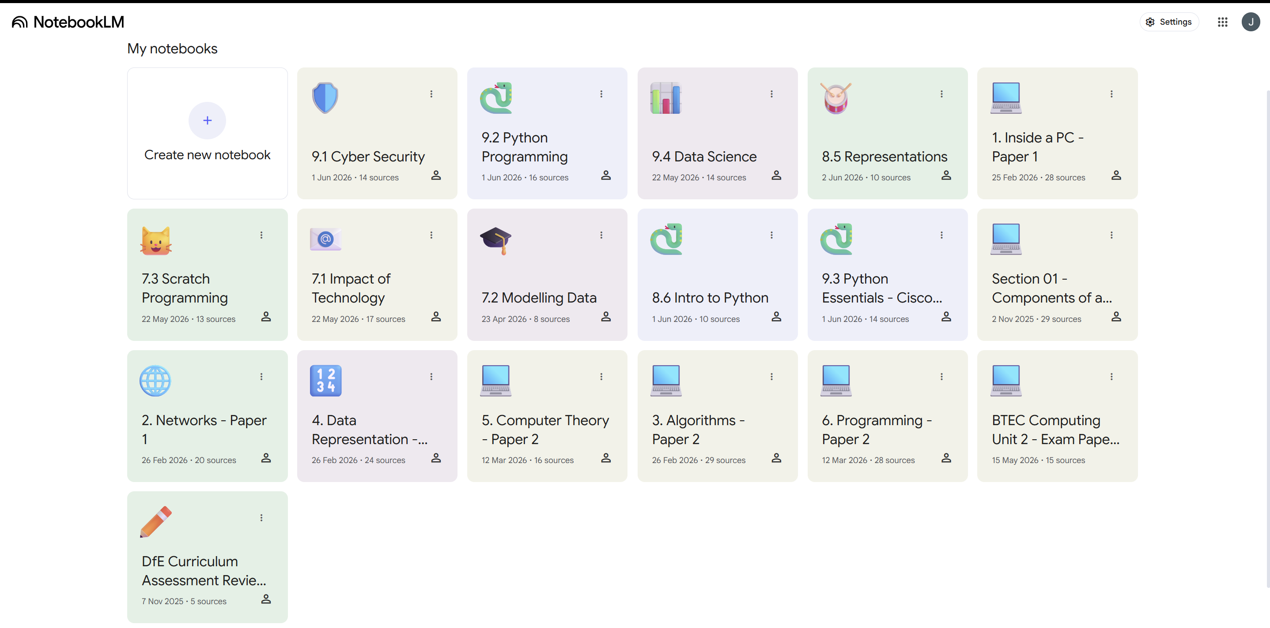
Notebook LM
LinkedIn: https://www.linkedin.com/in/joearday/
Twitter:
@TheAverageArday

Slide 9
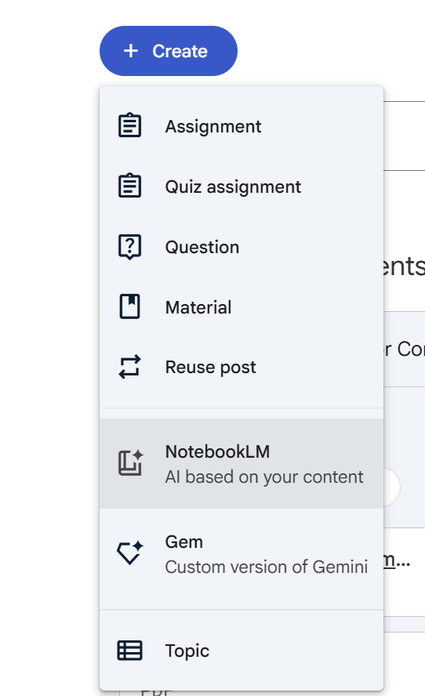
Notebook LM – Example via Google Classroom
An example of how to create topic revision using notebook LM to help students prepare for an end of topic class test.
LinkedIn: https://www.linkedin.com/in/joearday/
Twitter:
@TheAverageArday

Slide 10
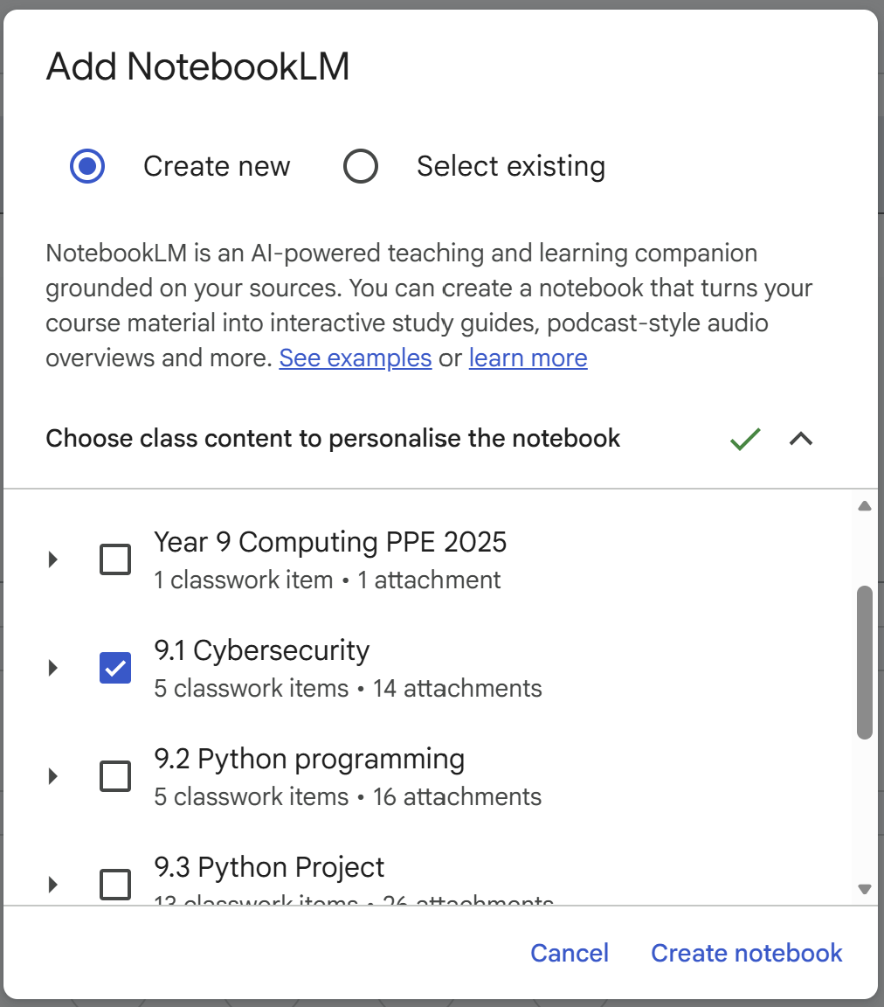
Notebook LM – Example via Google Classroom
An example of how to create topic revision using notebook LM to help students prepare for an end of topic class test.
LinkedIn: https://www.linkedin.com/in/joearday/
Twitter:
@TheAverageArday

Slide 11
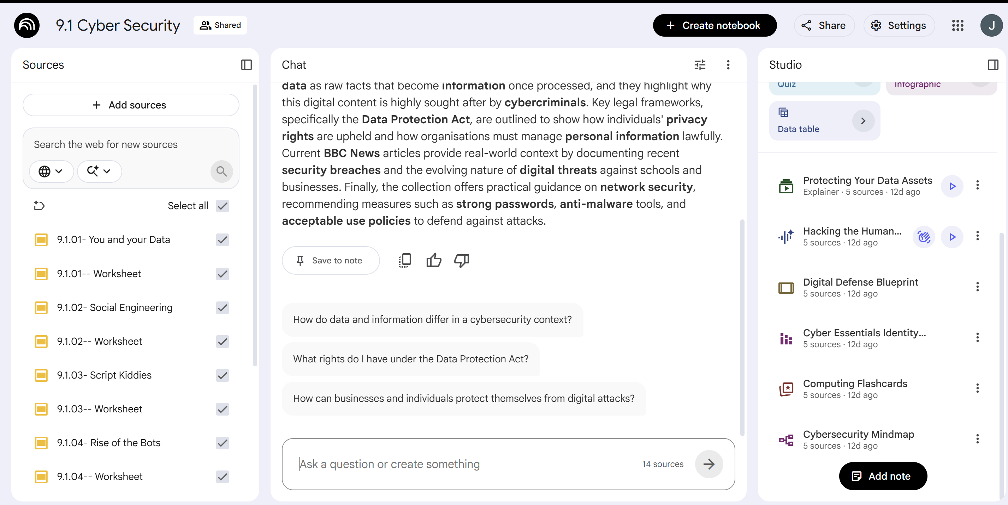
Notebook LM – Example via Google Classroom
Uploaded lesson resources can be converted into a podcast, short video, slide show, mind map, flashcards, spider diagram etc using the “studio” tools on Notebook LM.

Slide 12
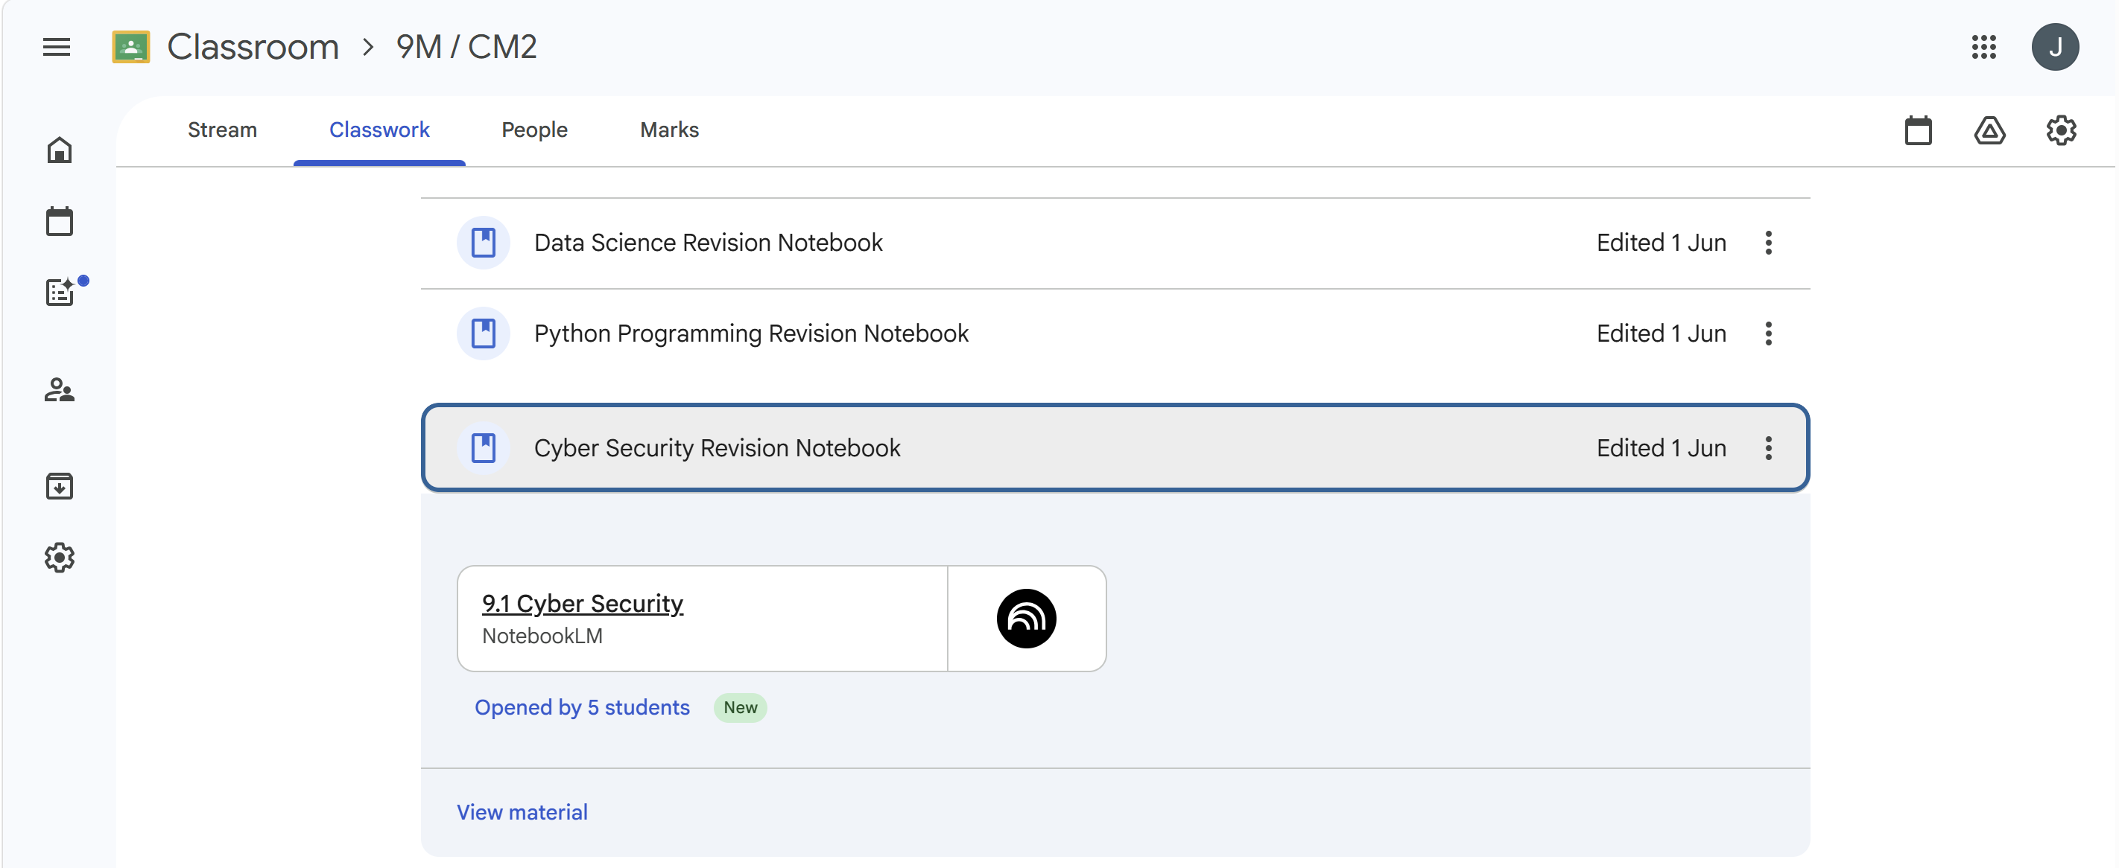
Notebook LM – Example via Google Classroom
The created topic revision notebook is automatically added to the “classwork” section on Google classroom.
LinkedIn: https://www.linkedin.com/in/joearday/
Twitter:
@TheAverageArday

Slide 13
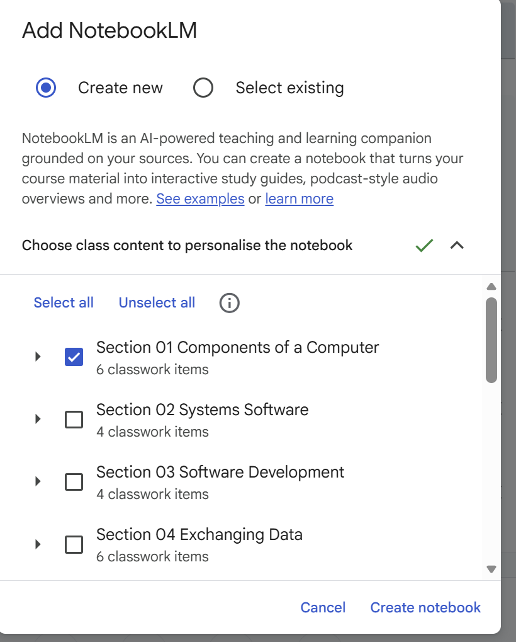
Notebook LM – Example via Google Classroom
A created revision notebook LM to summarise a topic (e.g. Paper 1 – Components of a Computer) in A level computer science using a range of lesson resources to produce podcasts, flashcards, video explanations, quizzes, mind maps and report to support post 16 students in preparation for class tests, mock exams etc.
LinkedIn: https://www.linkedin.com/in/joearday/
Twitter:
@TheAverageArday
Notes:
I have created a revision notebook LLM for all topics being covered in papers 1 and 2 of A level computer science based on the student lesson resources. I will also plan to update the lesson presentations for provide even more detail for the LLM.

Slide 14
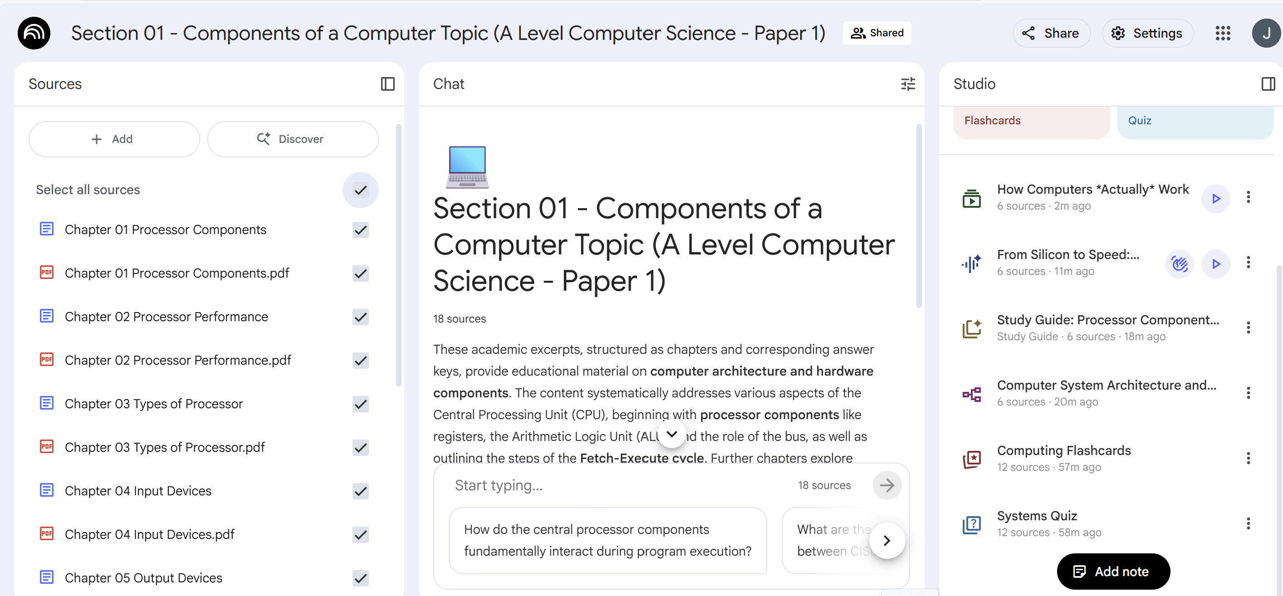
Notebook LM – Example via Google classroom
LinkedIn: https://www.linkedin.com/in/joearday/
Twitter:
@TheAverageArday

Slide 15
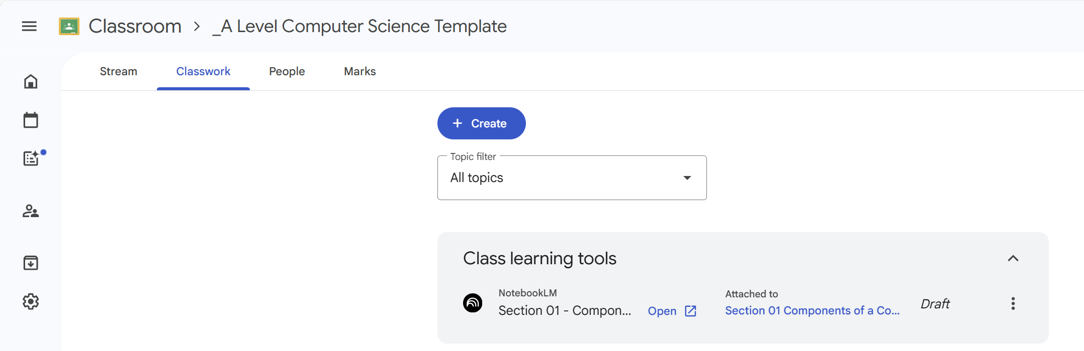
Notebook LM – Example via Google Classroom
LinkedIn: https://www.linkedin.com/in/joearday/
Twitter:
@TheAverageArday

Slide 16
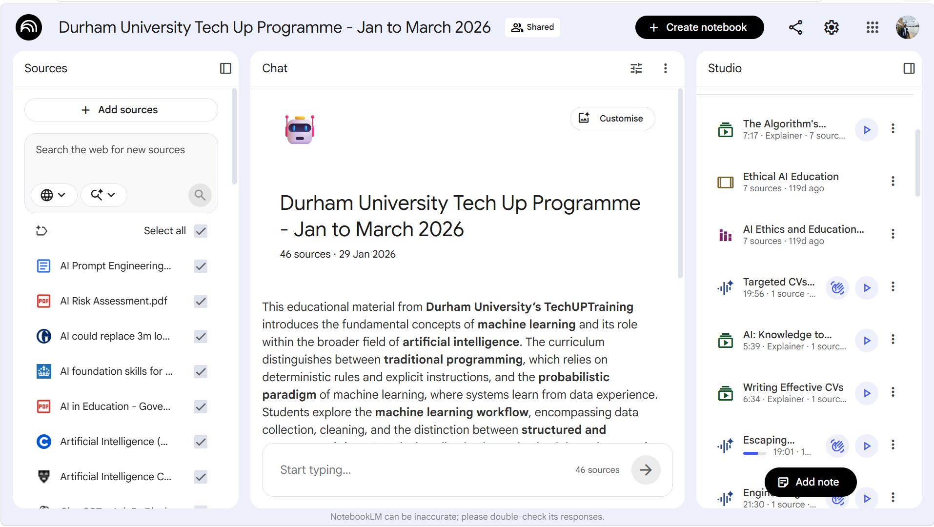
Notebook LM – Standalone example
Uploaded session resources from the Tech Up AI foundations programme, which I have converted into podcasts, short videos, slide shows, mind maps, flashcards, spider diagrams etc for each session using the “studio” tools on Notebook LM.
LinkedIn: https://www.linkedin.com/in/joearday/
Twitter:
@TheAverageArday

Slide 17
My personalised chatbot project
Created a personalised chatbot that focuses on providing guidance on further study and / or career options for mature ND students over 40.
My personalised chatbot was built to include career information on my career to date, information on masters and PhD programs in AI and computing disciplines as well as careers that mature students could go into after completion of a masters and / or PhD.
Link - https://agent.jotform.com/019e8a164d7e7dba97329f8156f05c97ff68
LinkedIn: https://www.linkedin.com/in/joearday/

Slide 18
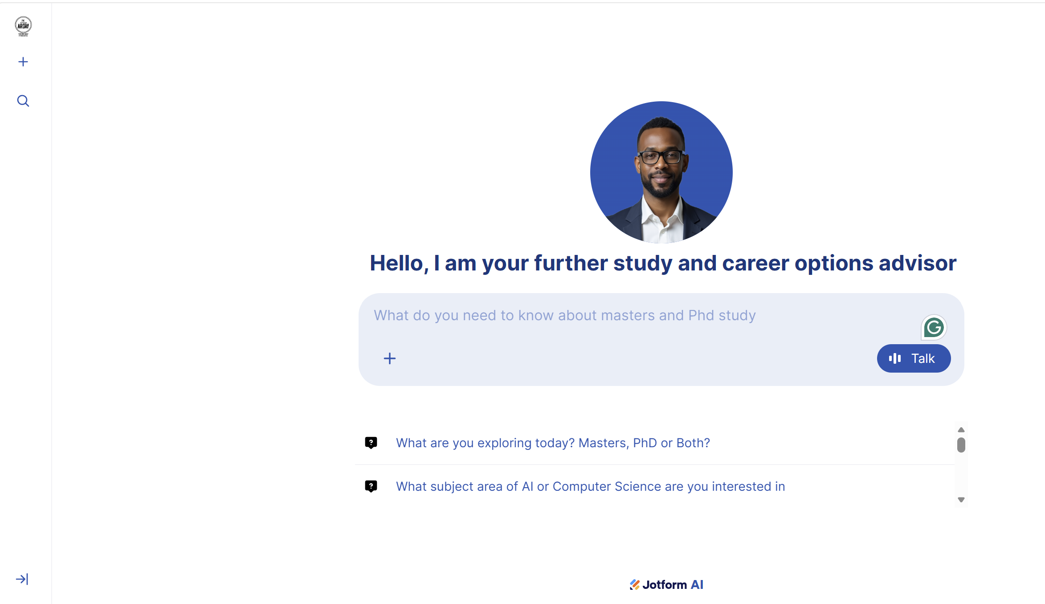
My personalised chatbot project – Standalone Version
Standalone version:
LinkedIn: https://www.linkedin.com/in/joearday/
Notes:
Link - https://agent.jotform.com/019e8a164d7e7dba97329f8156f05c97ff68

Slide 19
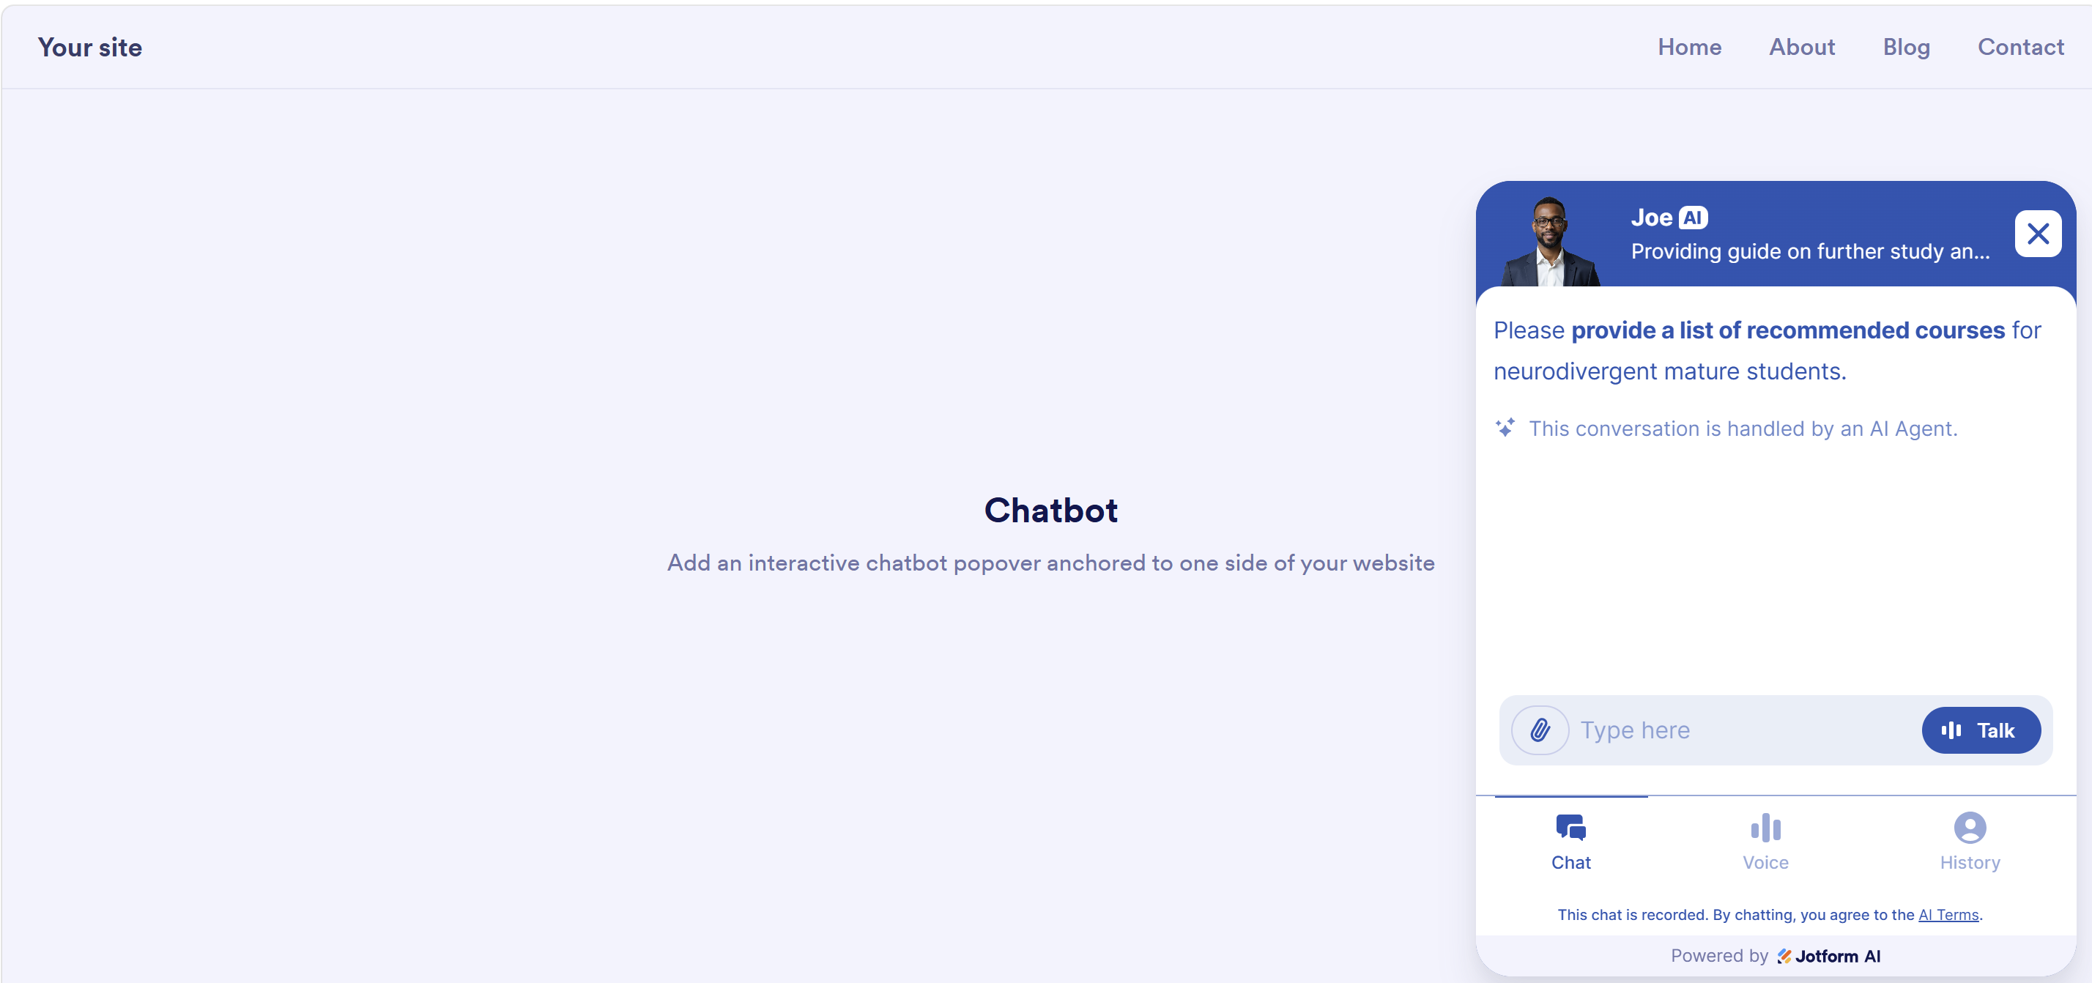
My personalised chatbot project – Website Version
Chatbot version on website (e.g. avatar or quick input):
LinkedIn: https://www.linkedin.com/in/joearday/
Notes:
Li

Slide 20
Capstone Project - Teaching ethical use of AI to students in key stages 3, 4 and 5
Students in years 7 to 10 were taught in computer science lessons about ethics and AI (key stage 3) and ethical AI (key stage 4) - encouraging young people to think about the ethical use of AI.
Post 16 students received two sessions on approved tools for AI use by the trust including discussions about the ethical uses of AI.
All post 16 students signed an “AI acceptable use” policy and undergo course training on AI such as completion of the cisco networking academy – “Introduction to modern AI” programme.

Slide 21
Recommend training courses for enhancing your productivity using AI
LinkedIn: https://www.linkedin.com/in/joearday/
Twitter:
@TheAverageArday

Slide 22
Resources – CPD Courses
Cisco Networking Academy: Introduction to Modern AI
BCS – AI Confidence: AI Confidence | BCS
AI Skills Boost: AI Skills Boost - AI Skills Hub
LinkedIn: https://www.linkedin.com/in/joearday/
Twitter:
@TheAverageArday

Slide 23
Resources – CPD Courses
Google:
Beginner: Introduction to Generative AI | Google Skills
Online Courses and Digital Marketing Training - Google
Applied Digital Skills : Google for Education
AI Boost Bites | Google Skills
Catalog | Google Skills
Google AI Professional Certificate | Google Skills

Slide 24
Resources – CPD Courses
Microsoft:
Use Microsoft Copilot to create training materials - Training | Microsoft Learn
Introduction to generative AI and agents - Training | Microsoft Learn
Generative AI for Beginners | Microsoft Learn
LinkedIn: https://www.linkedin.com/in/joearday/
Twitter:
@TheAverageArday

Slide 25
Any Questions?
LinkedIn: https://www.linkedin.com/in/joearday/
Twitter:
@TheAverageArday

Slide 26


Many thanks for attending today’s session
LinkedIn: https://www.linkedin.com/in/joearday/

